Slide 1
Extending the Shuffle Model of Differential Privacy to Vectors
Mary Scott
Joint work (in progress) with
Graham Cormode and Carsten Maple

Slide 2
Research Motivation
My research area is Privacy-Enhancing Technologies (PETs), with a particular focus on Differential Privacy (DP).
DP is a strong, mathematical definition of privacy in the context of statistical and machine learning analysis.
Provides mathematically provable guarantee of privacy protection against wide range of privacy attacks,
e.g. differencing attacks, linkage attacks, reconstruction attacks.
Ensures that any given disclosure is within a small multiplicative factor, whether or not an individual participates in the dataset.

Slide 3
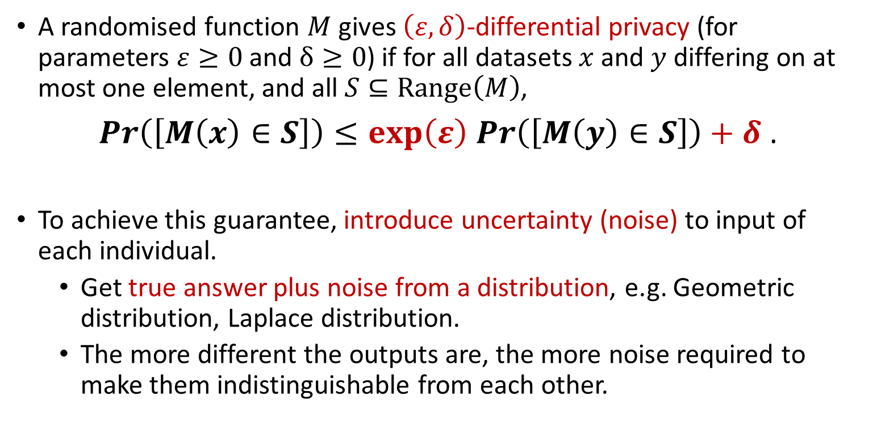
Research Motivation
A randomised function $M$ gives $\left(ε,δ\right)$-differential privacy (for parameters $ε≥0$ and $δ≥0$) if for all datasets $x$ and $y$ differing on at most one element, and all $S⊆Range\left(M\right)$,
$\operatorname{Pr}\left(\left[M\left(x\right)∈S\right]\right)≤\exp\left(ε\right)$ $\operatorname{Pr}\left(\left[M\left(y\right)∈S\right]\right)+δ$ .
To achieve this guarantee, introduce uncertainty (noise) to input of each individual.
Get true answer plus noise from a distribution, e.g. Geometric distribution, Laplace distribution.
The more different the outputs are, the more noise required to make them indistinguishable from each other.

Slide 4
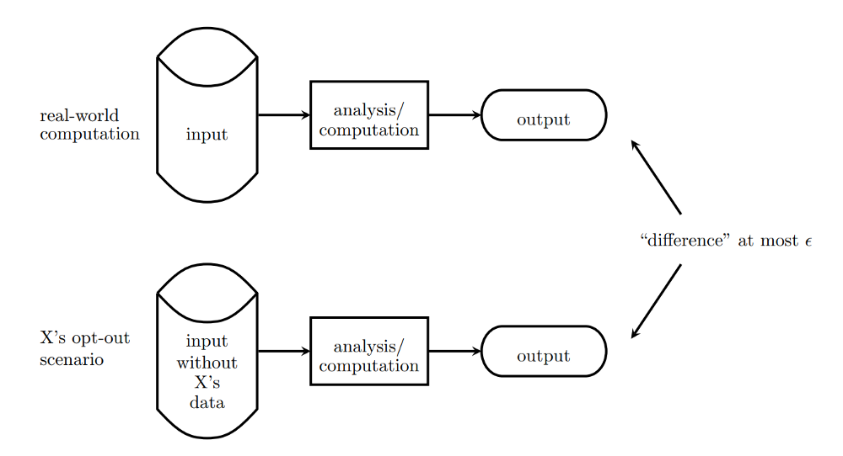
Research Motivation

Slide 5
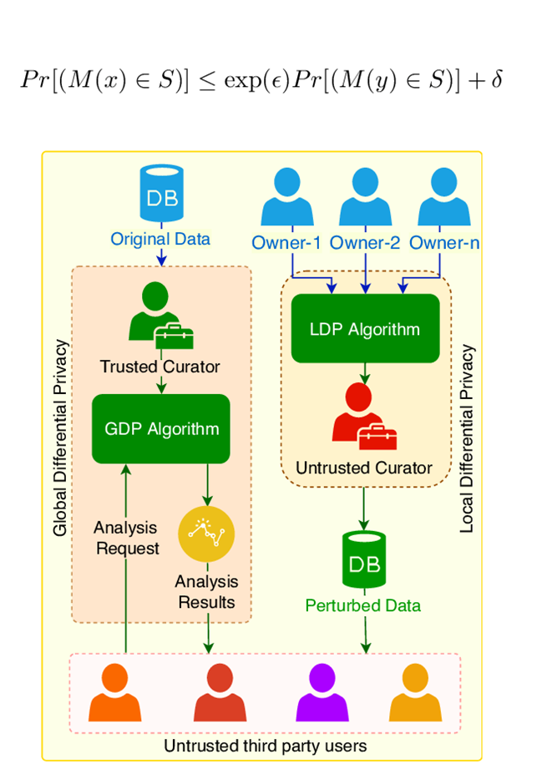
Models of Differential Privacy
Centralised Model of DP: users submit sensitive personal information directly to a trusted central data collector, who
adds random noise to raw data to provide DP,
and assembles and analyses the aggregated results.
Local Model of DP: each user applies a local randomiser to add random noise to their data before it is submitted.
No need for trusted party but noise required per user for same privacy guarantee is much higher.
Limits usage of Local Differential Privacy (LDP) to major companies, e.g. Google, Apple and Microsoft.
Neither provides a good balance between trust of central entity and level of noise required to guarantee DP.

Slide 6

The Shuffle Model of DP
The (Single-Message) Shuffle Model sits in between the Centralised and Local Models of DP:
noise required per user for same privacy guarantee is not as high as in the Local Model.
Introduces an additional “shuffling step” to the Local Model:
after the data from each user is encoded, it is randomly permuted to unbind each user from their data before analysis takes place.
Only introduced in 2019, there is much more work to be done.
Contrasts with general DP which was first defined in 2006.
Currently working on a protocol for vector-valued messages, extending an existing protocol only applicable for scalars.

Slide 7
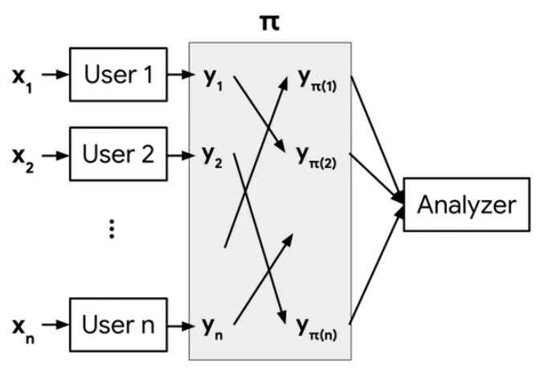
The Shuffle Model of DP

Slide 8
Extending the Shuffle Model to Vectors
Extended “The Privacy Blanket of the Shuffle Model” (Balle et al., 2019) to be applicable to vectors rather than just scalars.
Two contributions:
an optimal single message protocol for summation of real vectors in the Shuffle Model,
and an improvement of this bound through implementation of a Discrete Fourier Transform (DFT), which minimises initial error at expense of the loss in accuracy.
Contributions will aid in exploration of more sophisticated structures such as matrices and tensors in this context,
both of which are reliant on the functionality of the vector case.

Slide 9
Applications for Vector Data Collection
Why did I choose vectors specifically as the data type?
Practical applications in Federated Learning:
a Machine Learning (ML) setting where multiple users collaborate in solving a ML problem, under coordination of service provider.
e.g. training a Deep Neural Network to predict the next word that a user types,
where updates are high-dimensional vectors based on information from user’s private database.
Why did I investigate the aggregation of these vectors?
Closely related to Secure Aggregation:
used to privately compute outputs of local ML on user devices.
Example above requires only element-wise weighted averages of update vectors.

Slide 10
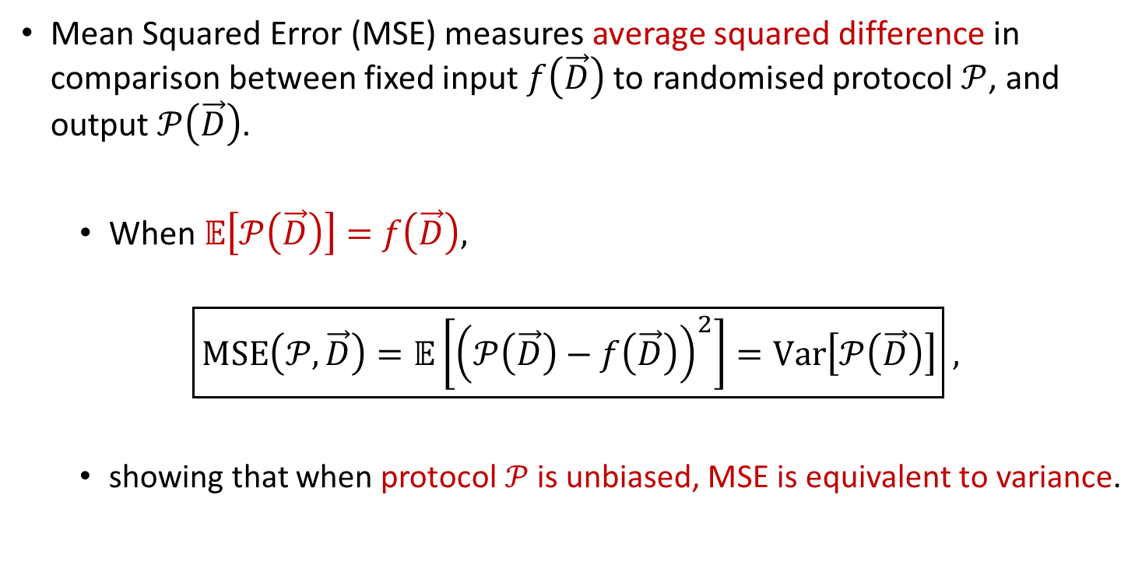
Accuracy Measure: Mean Squared Error (MSE)
Mean Squared Error (MSE) measures average squared difference in comparison between fixed input $f\left(\vec{D}\right)$ to randomised protocol $𝒫$, and output $𝒫\left(\vec{D}\right)$.
When $𝔼\left[𝒫\left(\vec{D}\right)\right]=$ $f\left(\vec{D}\right),$
$$\boxed{MSE\left(𝒫,\vec{D}\right)=𝔼\left[{\left(𝒫\left(\vec{D}\right)−f\left(\vec{D}\right)\right)}^{2}\right]=Var\left[𝒫\left(\vec{D}\right)\right]} ,$$
showing that when protocol $𝒫$is unbiased, MSE is equivalent to variance.

Slide 11
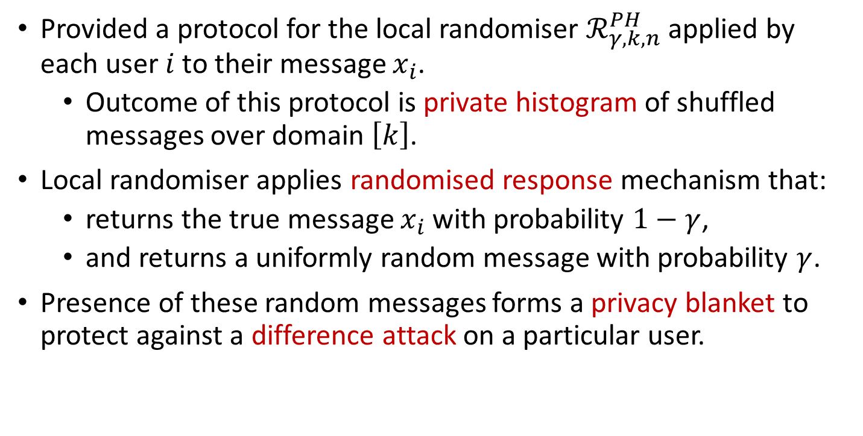
Protocol for the Local Randomiser
Provided a protocol for the local randomiser $ℛ_{γ,k,n}^{PH}$ applied by each user $i$ to their message $x_{i}$.
Outcome of this protocol is private histogram of shuffled messages over domain $\left[k\right]$.
Local randomiser applies randomised response mechanism that:
returns the true message $x_{i}$ with probability $1−γ$,
and returns a uniformly random message with probability $γ$.
Presence of these random messages forms a privacy blanket to protect against a difference attack on a particular user.

Slide 12
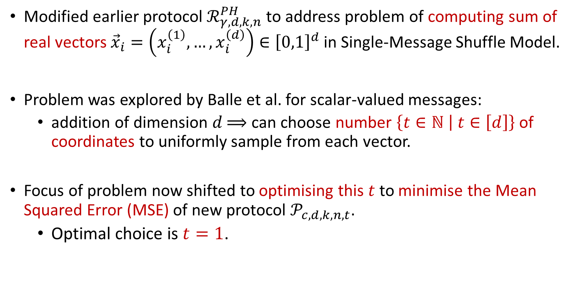
Modified Protocol for the Local Randomiser
Modified earlier protocol $ℛ_{γ,d,k,n}^{PH}$ to address problem of computing sum of real vectors ${\vec{x}}_{i}=\left(x_{i}^{\left(1\right)},…,x_{i}^{\left(d\right)}\right)∈{\left[0,1\right]}^{d}$ in Single-Message Shuffle Model.
Problem was explored by Balle et al. for scalar-valued messages:
addition of dimension $d$ $⟹$ can choose number $\left\{t∈ℕ | t∈\left[d\right]\right\}$ of coordinates to uniformly sample from each vector.
Focus of problem now shifted to optimising this $t$ to minimise the Mean Squared Error (MSE) of new protocol $𝒫_{c,d,k,n,t}$.
Optimal choice is $t=1$.

Slide 13
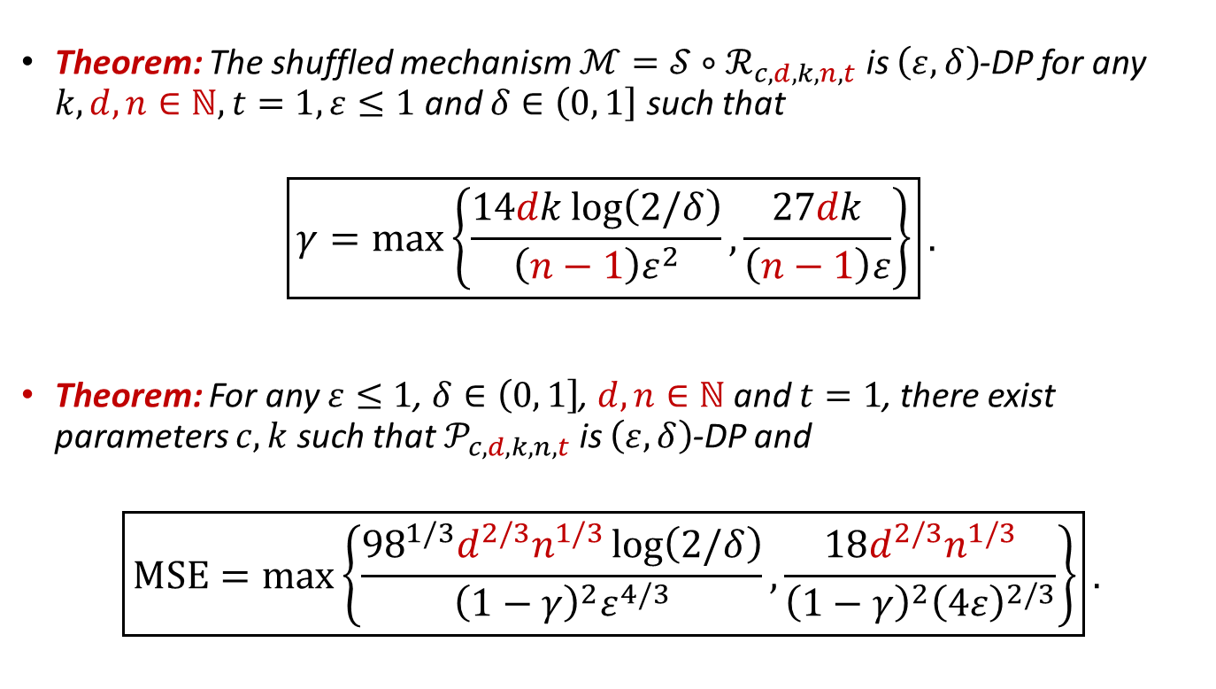
Privacy Analysis of Modified Protocol
Theorem: The shuffled mechanism $ℳ=𝒮∘ℛ_{c,d,k,n,t}$ is $\left(ε,δ\right)$-DP for any $k,d, n∈ℕ,t=1,ε≤1$ and $δ∈\left(0,\left.1\right]\right.$ such that
$$\boxed{γ=\max\left\{\frac{14dk\log\left(2/δ\right)}{\left(n−1\right)ε^{2}},\frac{27dk}{\left(n−1\right)ε}\right\}}.$$
Theorem: For any $ε≤1$, $δ∈\left(0,\left.1\right]\right.$, $d,n∈ℕ$ and $t=1$, there exist parameters $c,k$ such that $𝒫_{c,d,k,n,t}$ is $\left(ε,δ\right)$-DP and
$$\boxed{MSE=\max\left\{\frac{{98}^{1/3}d^{2/3}n^{1/3}\log\left(2/δ\right)}{{\left(1−γ\right)}^{2}ε^{4/3}},\frac{18d^{2/3}n^{1/3}}{{\left(1−γ\right)}^{2}{\left(4ε\right)}^{2/3}}\right\}}.$$

Slide 14
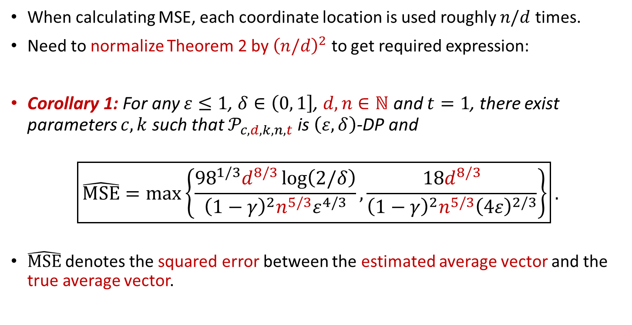
Normalizing the Mean Squared Error (MSE)
When calculating MSE, each coordinate location is used roughly $n/d$ times.
Need to normalize Theorem 2 by ${\left(n/d\right)}^{2}$ to get required expression:
Corollary 1: For any $ε≤1$, $δ∈\left(0,\left.1\right]\right.$, $d,n∈ℕ$ and $t=1$, there exist parameters $c,k$ such that $𝒫_{c,d,k,n,t}$ is $\left(ε,δ\right)$-DP and
$$\boxed{\hat{MSE}=\max\left\{\frac{{98}^{1/3}d^{8/3}\log\left(2/δ\right)}{{\left(1−γ\right)}^{2}{n^{5/3}ε}^{4/3}},\frac{18d^{8/3}}{{\left(1−γ\right)}^{2}{n^{5/3}\left(4ε\right)}^{2/3}}\right\}}.$$
$\hat{MSE}$ denotes the squared error between the estimated average vector and the true average vector.

Slide 15
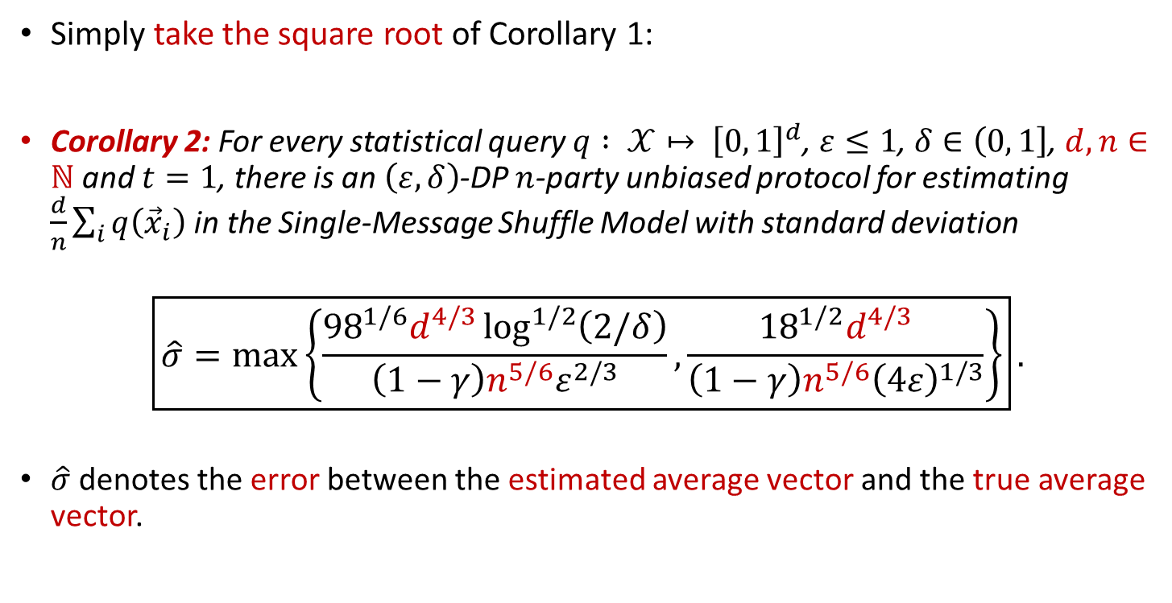
Useful Error: Between Average Vectors
Simply take the square root of Corollary 1:
Corollary 2: For every statistical query $q : 𝒳↦ {\left[0, 1\right]}^{d}$, $ε≤1$, $δ∈\left(0,\left.1\right]\right.$, $d,n∈ℕ$ and $t=1$, there is an $\left(ε,δ\right)$-DP $n$-party unbiased protocol for estimating $\frac{d}{n}\sum_{i}{q\left({\vec{x}}_{i}\right)}$ in the Single-Message Shuffle Model with standard deviation
$$\boxed{\hat{σ}=\max\left\{\frac{{98}^{1/6}d^{4/3}\log^{1/2}\left(2/δ\right)}{\left(1−γ\right){n^{5/6}ε}^{2/3}},\frac{{18}^{1/2}d^{4/3}}{{\left(1−γ\right)n^{5/6}\left(4ε\right)}^{1/3}}\right\}}.$$
$\hat{σ}$ denotes the error between the estimated average vector and the true average vector.

Slide 16
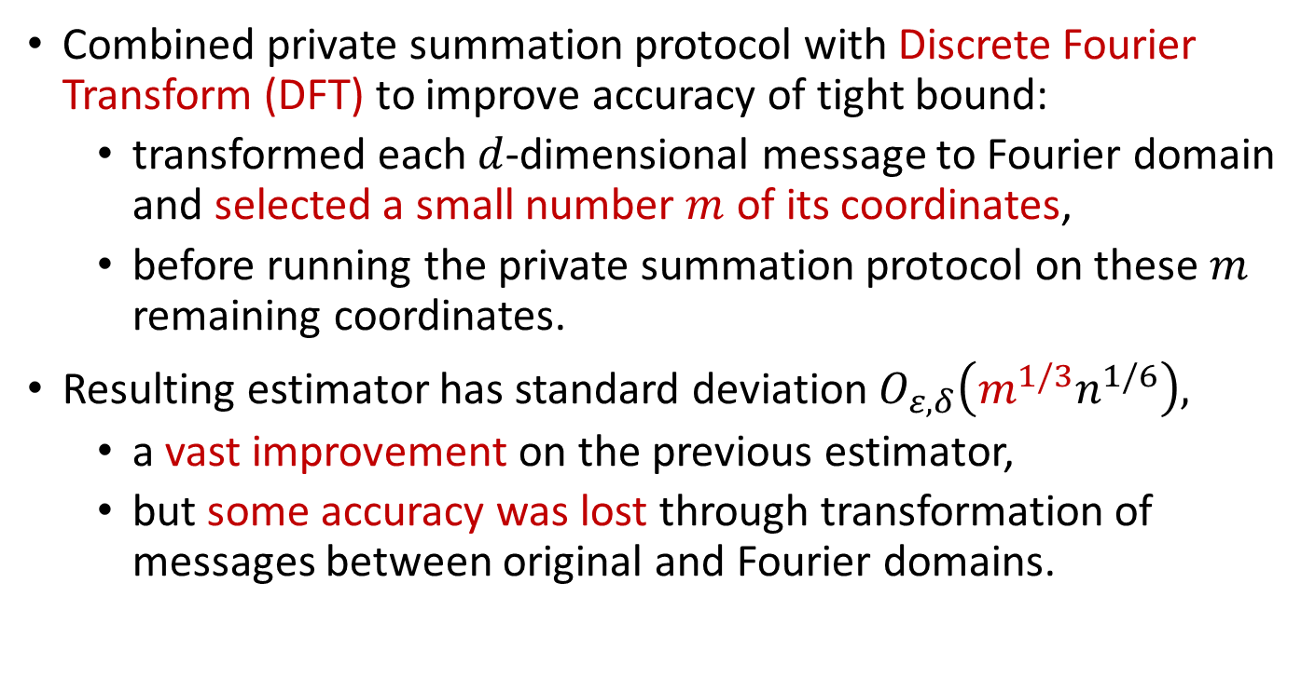
Adding a Discrete Fourier Transform
Combined private summation protocol with Discrete Fourier Transform (DFT) to improve accuracy of tight bound:
transformed each $d$-dimensional message to Fourier domain and selected a small number $m$ of its coordinates,
before running the private summation protocol on these $m$ remaining coordinates.
Resulting estimator has standard deviation $O_{ε,δ}\left(m^{1/3}n^{1/6}\right),$
a vast improvement on the previous estimator,
but some accuracy was lost through transformation of messages between original and Fourier domains.

Slide 17
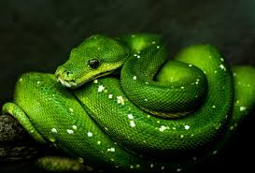
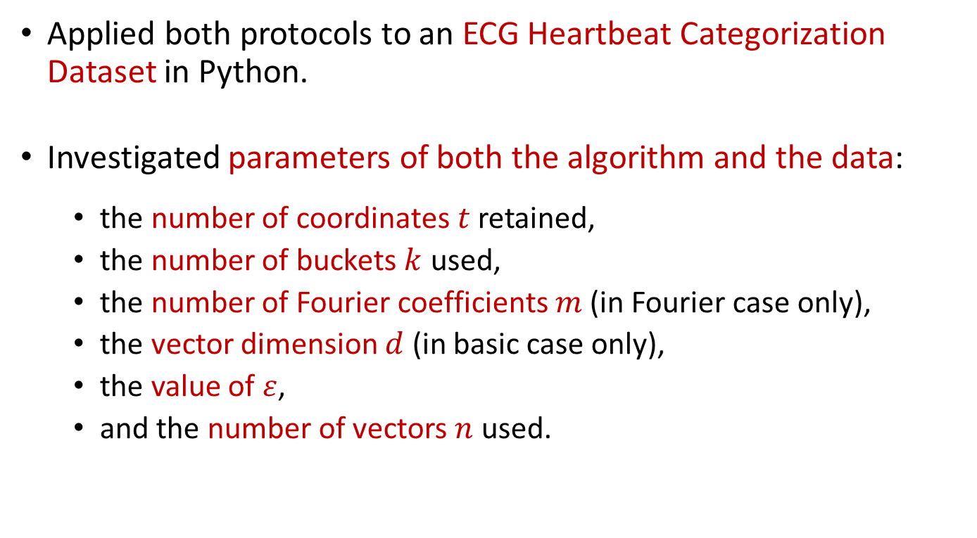
Experimental Evaluation
Applied both protocols to an ECG Heartbeat Categorization Dataset in Python.
Investigated parameters of both the algorithm and the data:
the number of coordinates $t$ retained,
the number of buckets $k$ used,
the number of Fourier coefficients $m$ (in Fourier case only),
the vector dimension $d$ (in basic case only),
the value of $ε$,
and the number of vectors $n$ used.

Slide 18
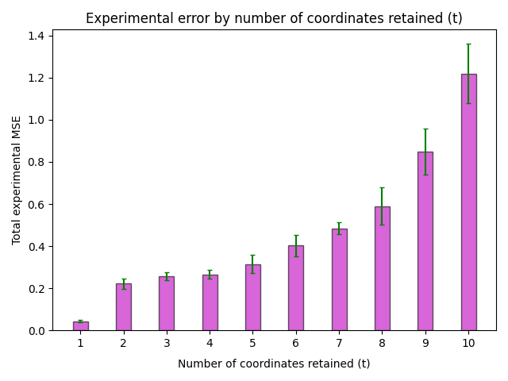
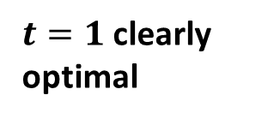
$t=1$ clearly optimal

Slide 19
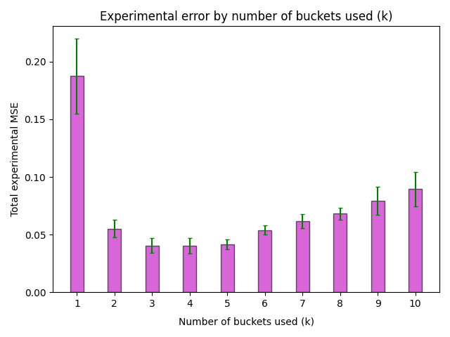
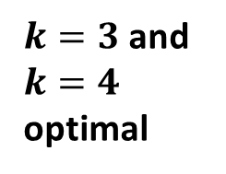
$k=3$ and $k=4$ optimal

Slide 20
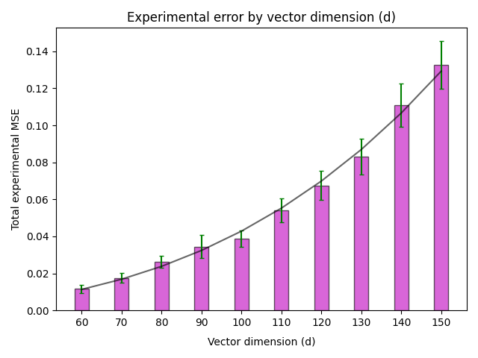
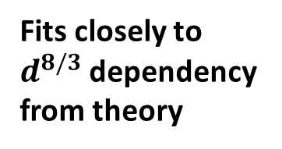
Fits closely to $d^{8/3}$ dependency from theory

Slide 21
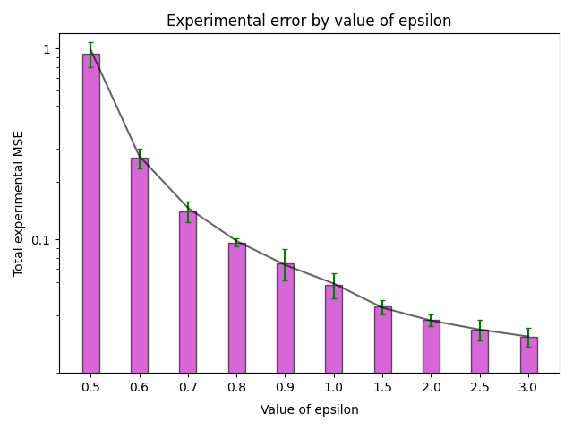
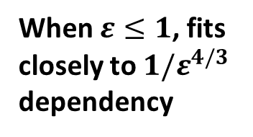
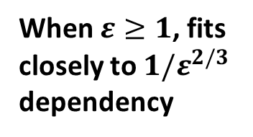
When $ε≤1$, fits closely to ${1/ε}^{4/3}$ dependency
When $ε≥1$, fits closely to ${1/ε}^{2/3}$ dependency

Slide 22
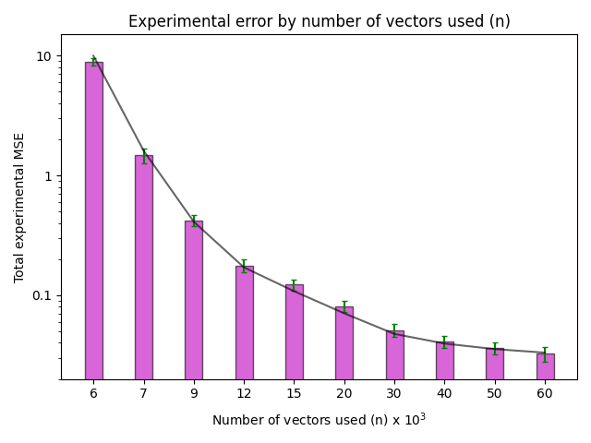
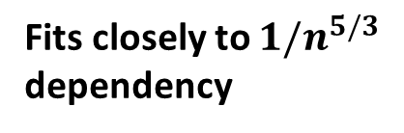
Fits closely to $1/n^{5/3}$ dependency

Slide 23
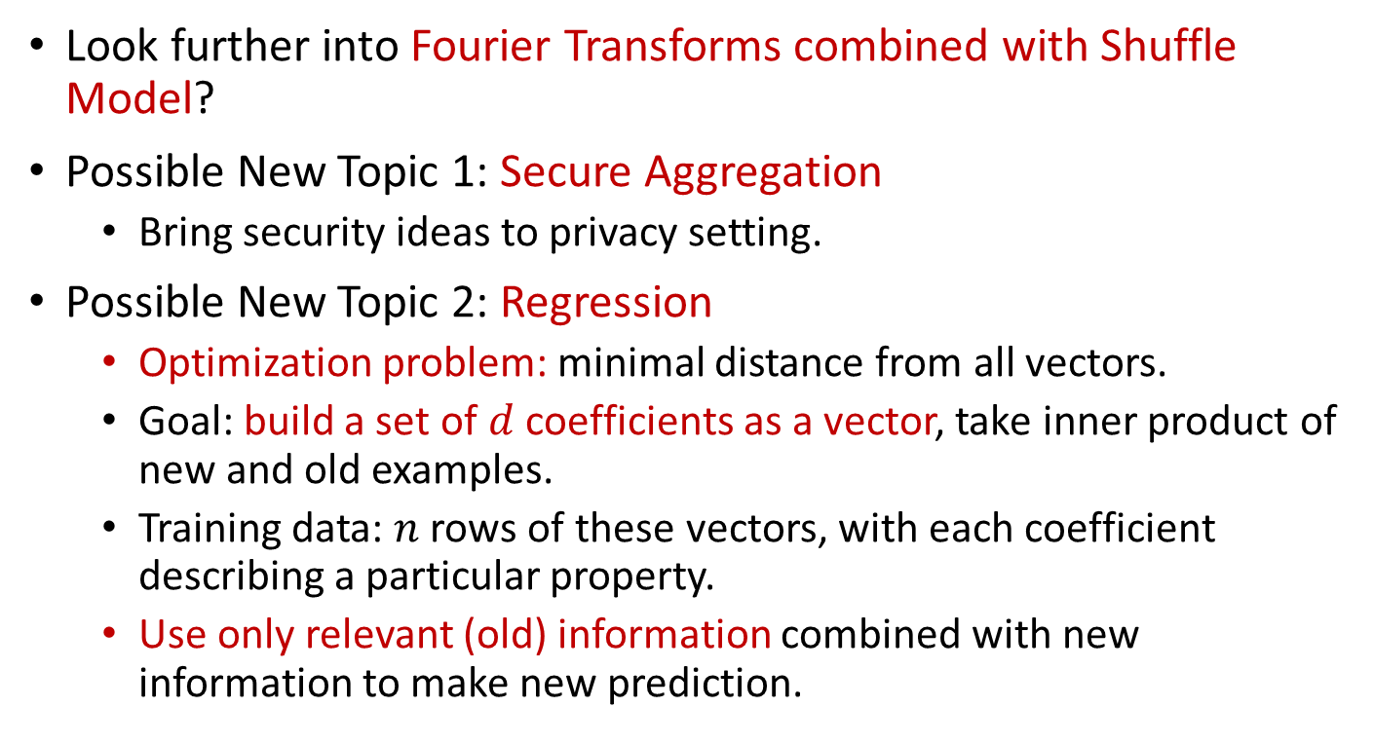
What’s Next?
Look further into Fourier Transforms combined with Shuffle Model?
Possible New Topic 1: Secure Aggregation
Bring security ideas to privacy setting.
Possible New Topic 2: Regression
Optimization problem: minimal distance from all vectors.
Goal: build a set of $d$ coefficients as a vector, take inner product of new and old examples.
Training data: $n$ rows of these vectors, with each coefficient describing a particular property.
Use only relevant (old) information combined with new information to make new prediction.

Slide 24
Thank you for listening ☺
Any questions?

